Slide 1


Electricity and Circuits
Class 6 | Science

Slide 2
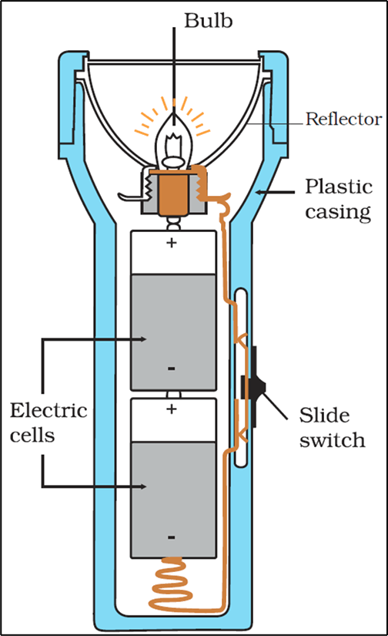
Inside View of a Torch

Slide 3

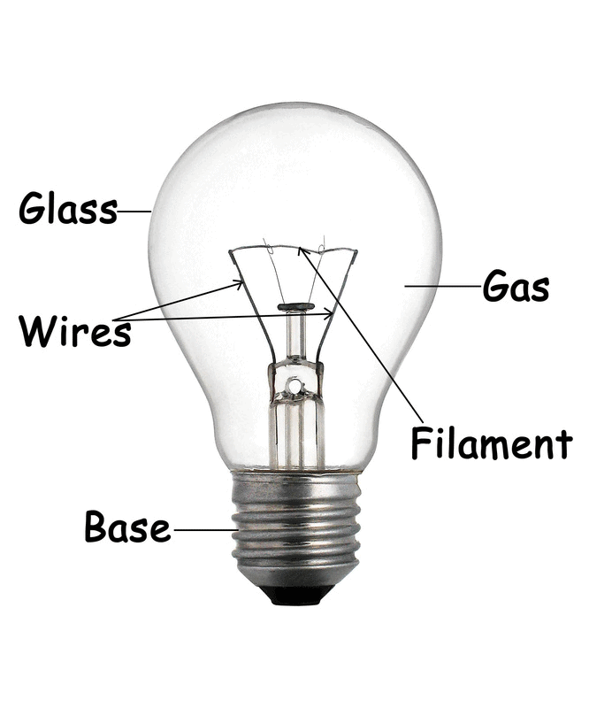
Electric Bulb
An electric bulb is a small and simple light source that uses a wire filament to glow when electricity passes through it.

Slide 4
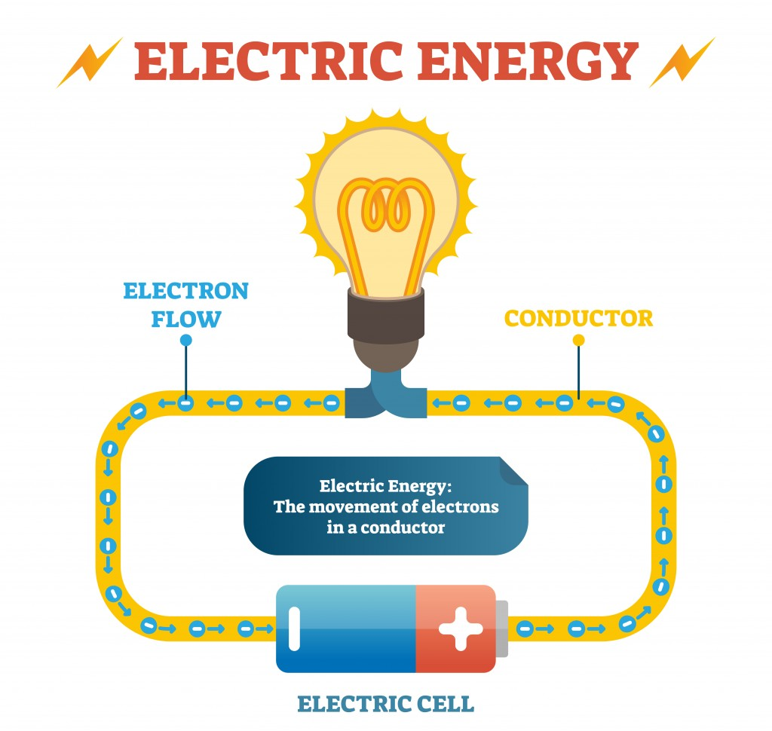
Electrical Energy
Electrical energy is caused by moving electric charges called electrons.
The faster the charges move, the more electrical energy they carry.

Slide 5
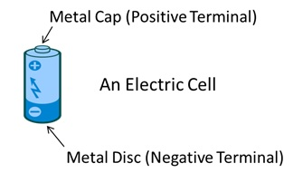
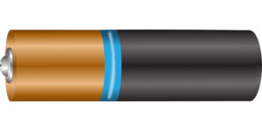
Electric cell
An electric cell is a device, which converts chemical energy into electrical energy.

Slide 6
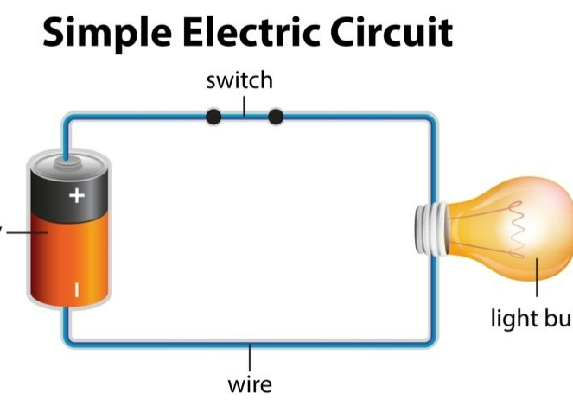
Electric Circuit
An electric circuit is a path along which electricity can flow.
A simple electric circuit consist of a cell, torch bulb and two pieces of wire (called connecting wires).

Slide 7
Types of Circuit
Open Circuit
Closed Circuit
It is not a closed and continuous path.
Electric current doesn't flow in an open circuit
The key in an open circuit is shown as ()
It is a closed and continuous path.
Electric current flows in a closed circuit
The key in a closed circuit is shown as (.)

Slide 8
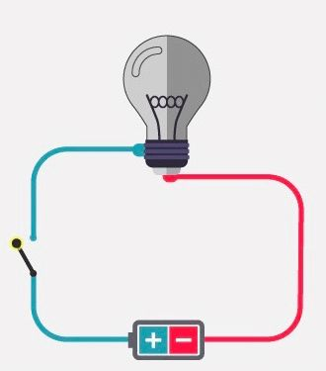
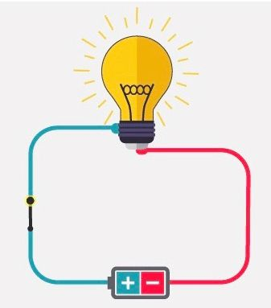
Switch
Open Switch
Closed Switch
A switch is said to be open when no current is drawn from the cell, and the circuit is open or incomplete.
A switch is said to be closed when current is drawn from the cell and the circuit is closed or complete.

Slide 9

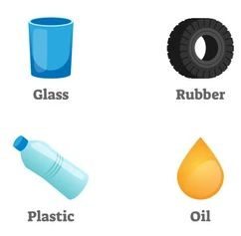
Type of Substances
Conductors
Insulators
They are the substance which allow the electricity to pass through them.
allow free flow of electrons
Examples: iron rods, steel etc.
They are the substance which do not allow the electricity to pass through them.
resist free flow of electrons
Examples: plastic, wood etc.

Slide 10
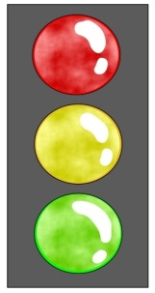
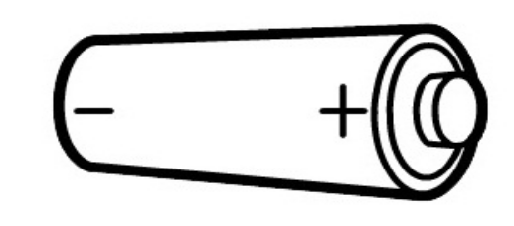

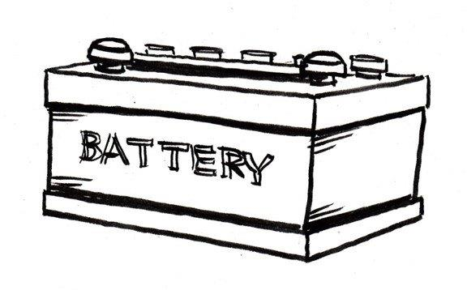
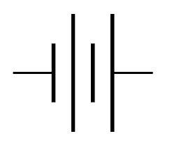
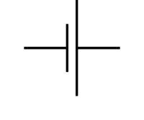


Symbols used to represent different components in a simple circuit
battery cell wire/conductor
Natural Sciences and Technology - Grade 6

Slide 11
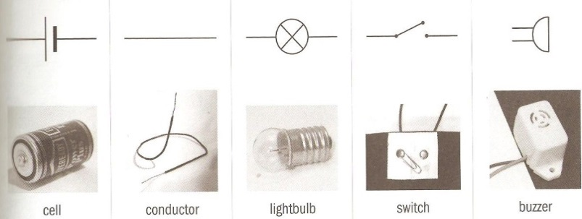





Symbols used to represent different components in a simple circuit
Open switch light bulb closed switch
Natural Sciences and Technology - Grade 6

Slide 12
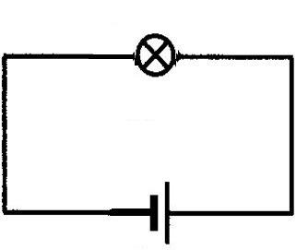
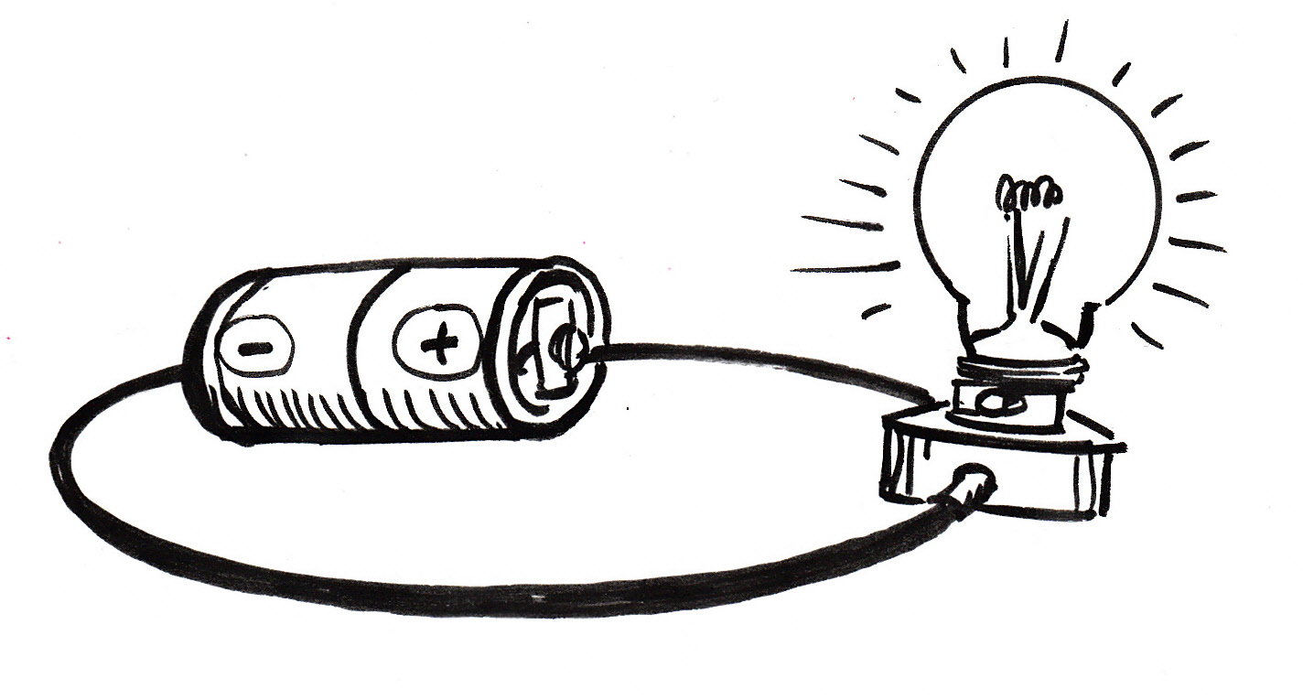
A cell and a light bulb
Natural Sciences and Technology - Grade 6

Slide 13
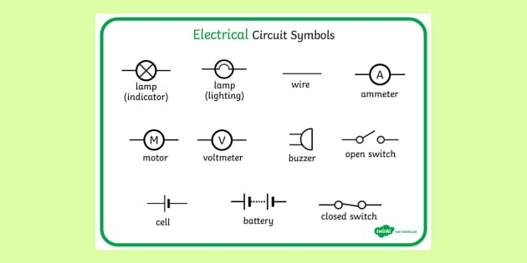

Slide 14
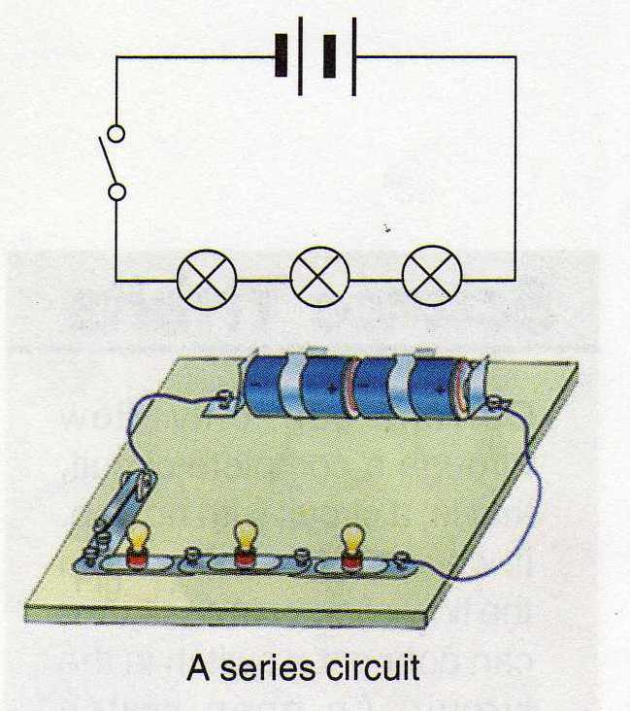
Series Circuit
A series circuit is one that connects an electrical source with its components one after another, forming one single loop.

Slide 15
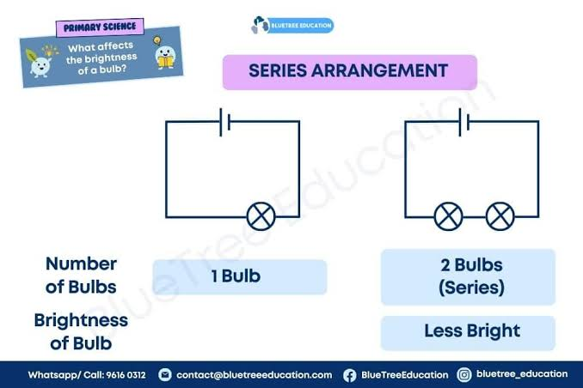

Slide 16
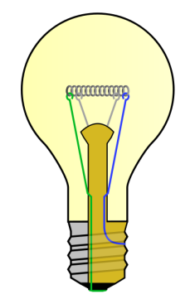

If there is only one path for the current you have a
series circuit.

Slide 17
With a series circuit, if one appliance is removed the circuit is opened by a gap. The other appliance goes off because current can’t flow to it.
A gap opens the circuit and stops the flow of current
Light is off

Slide 18
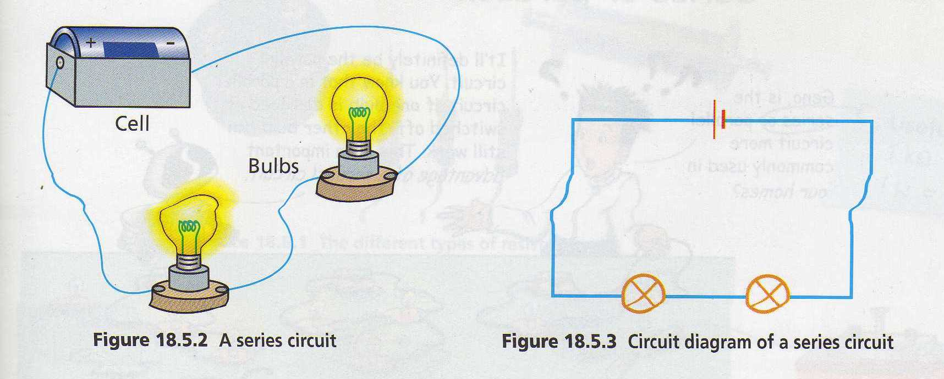
Series Circuit
There is only one path for the current to flow through.
The current flows through the first bulb, then through the next bulb, to light up all the bulbs.

Slide 19
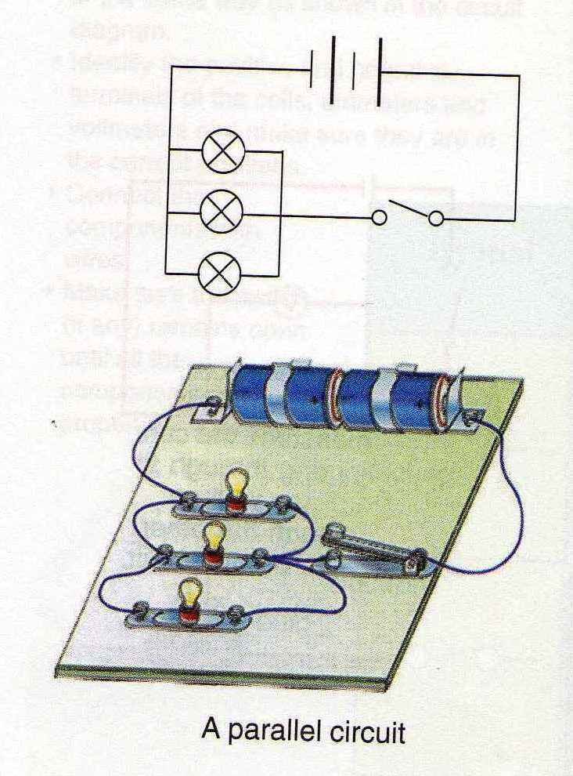
Parallel circuit
A parallel circuit is one that splits into two or more branches.

Slide 20
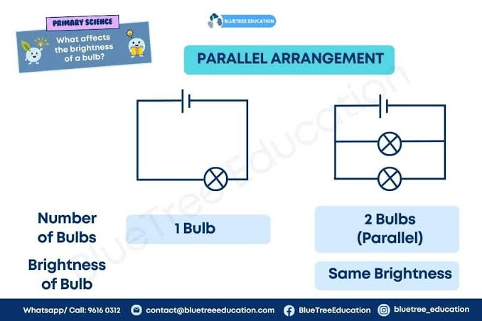

Slide 21
But we could make a circuit with more than one path for the current.

Slide 22
Then if one light is gone the other can stay on.

Slide 23
Then if one light is gone the other can stay on.

Slide 24
Then if one light is gone the other can stay on.
This is called a parallel circuit.

Slide 25
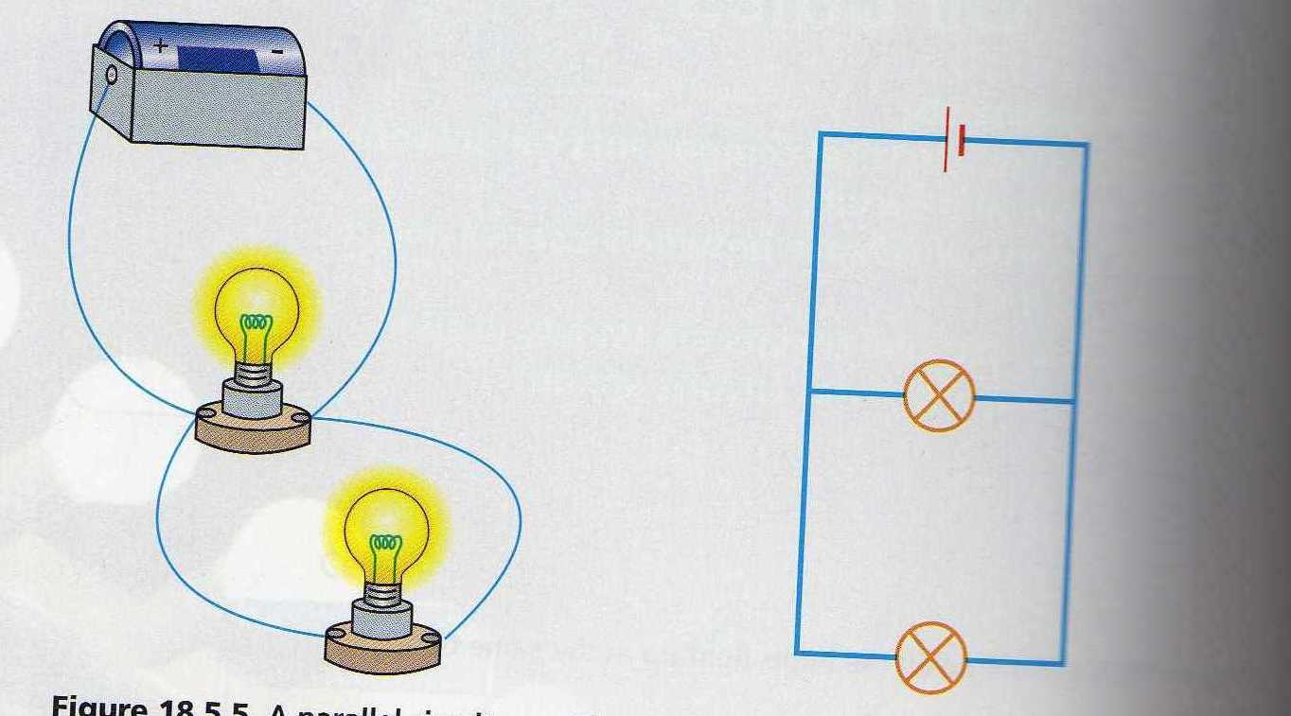
Parallel circuit
There is more than one path for the current to flow through.
Some current passes through one bulb and the rest flows through the other bulb.

Slide 26

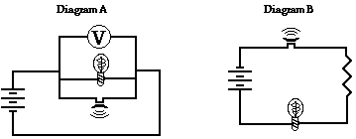
Disadventages of series circuit are:
If one lamp removed (dropped) then other
lights go out.
Flame lights with each other is not as obvious.
The farther from the power source increasingly dim lights.
Adventage of series circuit is:
Saving wiring and switch (cost-effective).
If several lamps are connected in series they will all be switched on and off together by a switch connected anywhere in the circuit.

Slide 27
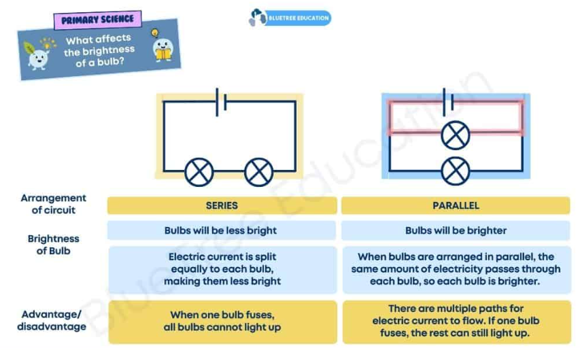

Slide 28
Disadventage of parallel electrical circuit is:
Wasteful cable and switch.
Adventages of parallel circuit are:
It allows each lamp to be turned on or off without affecting the others.
If one lamp blows, the others stay on.
Each lamp has the same (full) voltage; this may be important if you have a 110V supply say, and each lamp is designed for 110V.

Slide 29
What kind of circuit is more commonly used?
Parallel circuit

Slide 30
Why use parallel circuit in the household lighting?
If one bulb is damaged or switched off, the other bulb can still work.

Slide 31
Which type of lighting circuit connection has voltage is divided equally between the lamps? ( assuming they are all identical).
Series circuit

Slide 32
Review:
What is the name for a circuit that has only one path for current to flow?
Series circuit

Slide 33
Review:
What happens to the lights in a series circuit if one light goes off? And why?
All the lights go off. Because of the gap. There is no other path for the current.

Slide 34
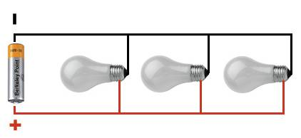
Review:
What happens when one light goes out in a parallel circuit?
The other lights can stay on.

Slide 35
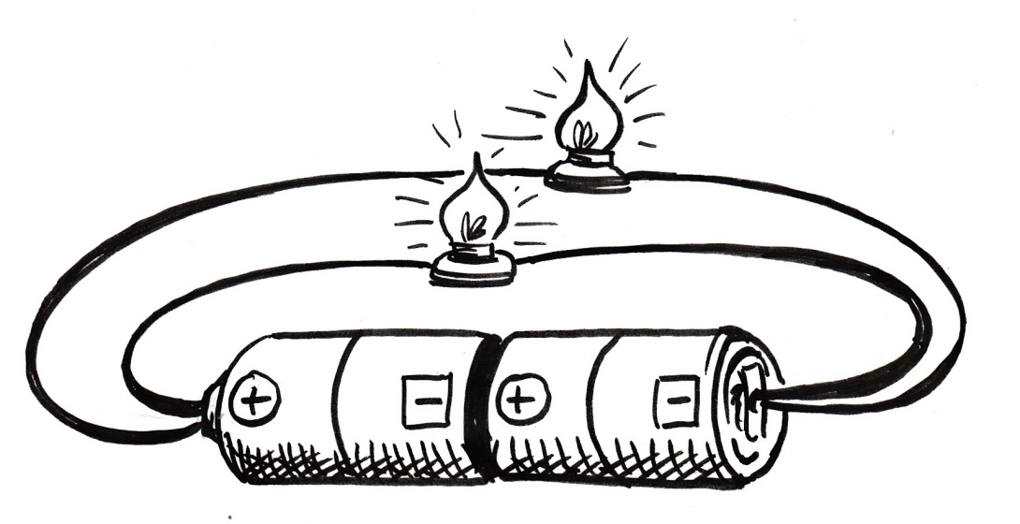
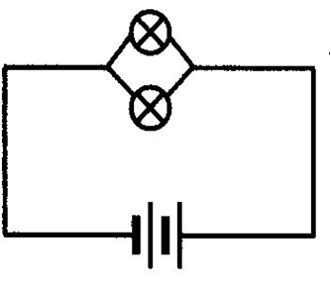
Two light bulbs in parallel and two cells in series
Natural Sciences and Technology - Grade 6

Slide 36
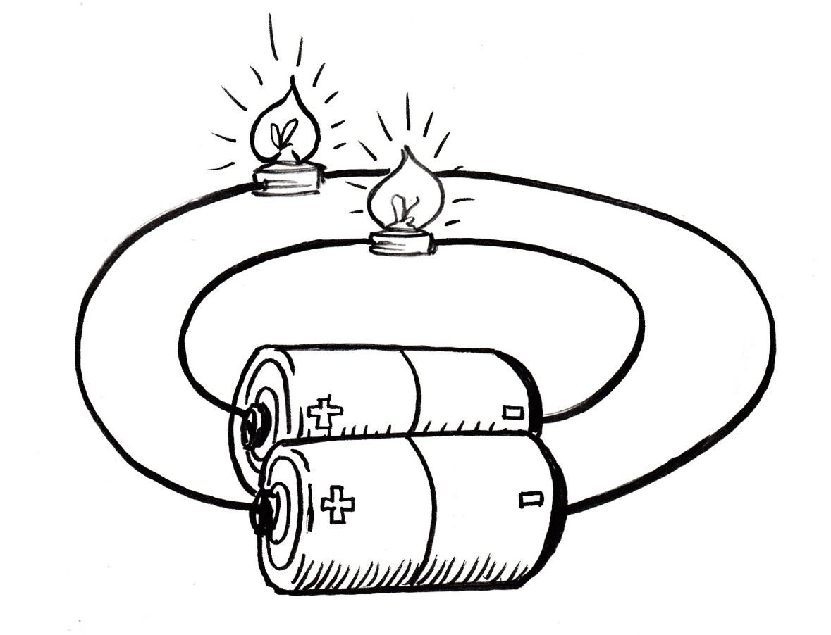
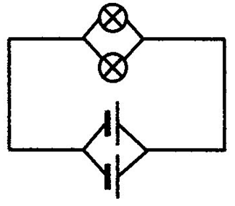
Two parallel cells and two parallel light bulbs
Natural Sciences and Technology - Grade 6

